Slide 1
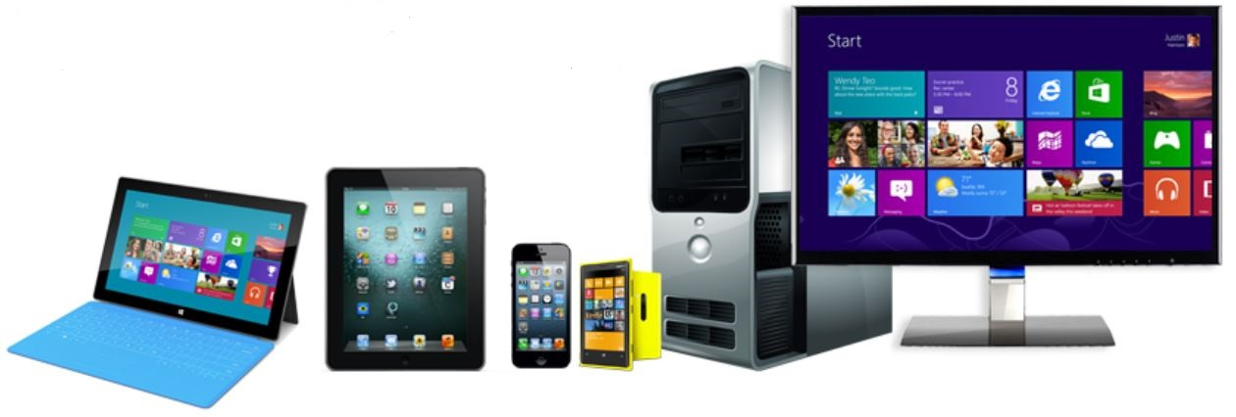
Chapter 1 – Computer Systems

Slide 2
CS 345
Stalling’s Chapter | # | Project
1: Computer System Overview 2: Operating System Overview | 4 | P1: Shell
3: Process Description and Control 4: Threads | 4 | P2: Tasking
5: Concurrency: ME and Synchronization 6: Concurrency: Deadlock and Starvation | 6 | P3: Jurassic Park
7: Memory Management 8: Virtual memory | 6 | P4: Virtual Memory
9: Uniprocessor Scheduling 10: Multiprocessor and Real-Time Scheduling | 6 | P5: Scheduling
11: I/O Management and Disk Scheduling 12: File Management | 8 | P6: FAT
Student Presentations | 6

Slide 3
Learning Objectives
Describe the basic elements of a computer system and their interrelationship.
Explain the steps taken by a processor to execute an instruction.
Understand the concept of interrupts and how and why a processor uses interrupts
List and describe the levels of a typical computer memory hierarchy.
Explain the basic characteristics of multiprocessor and multicore organization.
Discuss the concept of locality and analyze the performance of a multilevel memory hierarchy.
Understand the operation of a stack and its use to support procedure call and return.

Slide 4
OS345
P4: Virtual Memory
os345p4.c
os345mmu.c
os345lc3.c
P1: Shell
os345p1.c
P3: Jurassic Park
os345p3.c
os345park.c
P6: FAT File Manager
os345p6.c
os345FAT.c
P2: Tasking
os345p2.c
P5: FSS Scheduling
os345p5.c
P1, P2
os345tasks.c
os345semaphores.c
os345.c
os345interrupts.c
os345signals.c
P1, P2, P5

Slide 5
Learning Objectives
Describe the basic elements of a computer system and their interrelationship.
Explain the steps taken by a processor to execute an instruction.
Understand the concept of interrupts and how and why a processor uses interrupts
List and describe the levels of a typical computer memory hierarchy.
Explain the basic characteristics of multiprocessor and multicore organization.
Discuss the concept of locality and analyze the performance of a multilevel memory hierarchy.
Understand the operation of a stack and its use to support procedure call and return.

Slide 6
Processor Registers
Registers
User-visible registers
May be referenced by machine language
Available to all programs - application programs and system programs
Data Registers – can be changed by user
Address Registers – could be separate from data register
Stack Registers – user / supervisor stacks
Condition Codes – results of operations
Control and status registers
May or may not be visible
Program Counter (PC) – address of next instruction
Instruction Register (IR) – most recently fetched instruction
MAR/MBR – memory reference registers
Program Status Word (PSW) – condition codes, interrupts, mode

Slide 7
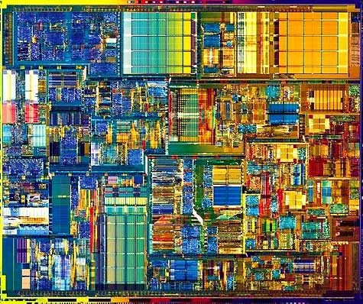
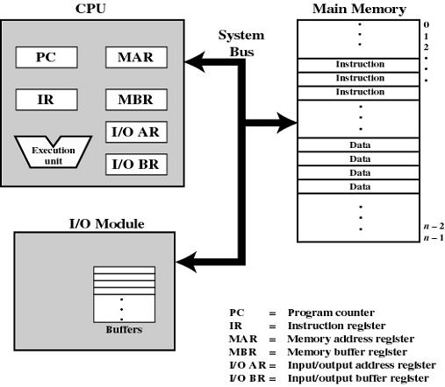
CPU
Registers

Slide 8
Instruction Execution
Registers

Slide 9
Instruction Execution
Registers

Slide 10
Learning Objectives
Describe the basic elements of a computer system and their interrelationship.
Explain the steps taken by a processor to execute an instruction.
Understand the concept of interrupts and how and why a processor uses interrupts
List and describe the levels of a typical computer memory hierarchy.
Explain the basic characteristics of multiprocessor and multicore organization.
Discuss the concept of locality and analyze the performance of a multilevel memory hierarchy.
Understand the operation of a stack and its use to support procedure call and return.

Slide 11






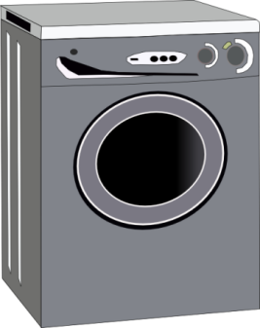

Interrupt Service Routines
Interrupt Service Routine
Interrupt
Main Routine
(synchronous)
Main Routine
(synchronous)
Main Routine
(synchronous)
Main Routine
(synchronous)
Interrupt Service Routine
(asynchronous)
Interrupt Service Routine
(asynchronous)
Interrupt Service Routine
(asynchronous)

Slide 12
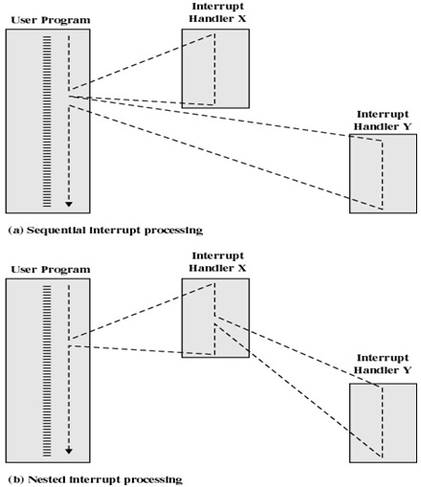
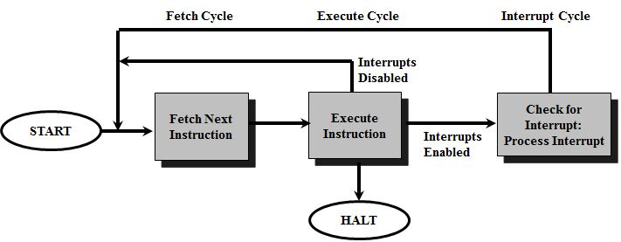
Interrupts
The interrupt was the principle tool available to system programmers in developing multi-tasking systems!
Classes of Interrupts
Program: arithmetic overflow, division by zero
Execute illegal instruction
Reference outside user’s memory space
I/O: Timer, DMA
Hardware failure
Interrupt control
Disable during ISR
Enable upon exiting
Allow Interrupts?
Priorities?

Slide 13
Learning Objectives
Describe the basic elements of a computer system and their interrelationship.
Explain the steps taken by a processor to execute an instruction.
Understand the concept of interrupts and how and why a processor uses interrupts
List and describe the levels of a typical computer memory hierarchy.
Explain the basic characteristics of multiprocessor and multicore organization.
Discuss the concept of locality and analyze the performance of a multilevel memory hierarchy.
Understand the operation of a stack and its use to support procedure call and return.

Slide 14
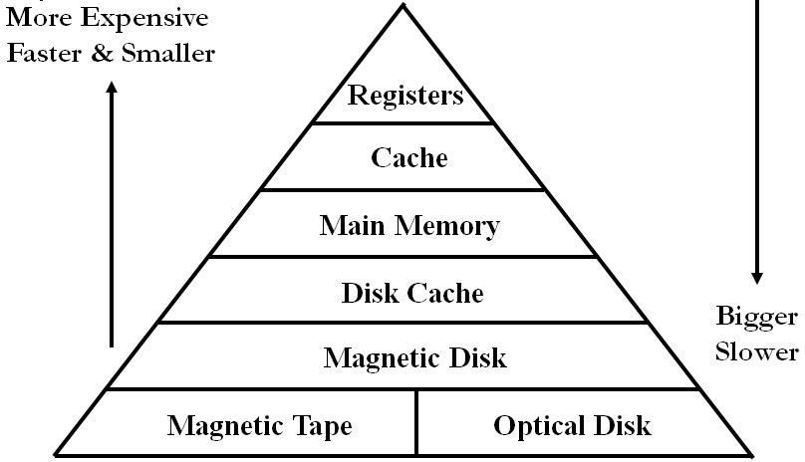
Storage Performance
Level | 1
Name | Registers
Typical Size | < 1KB
Implementation Technology | Custom memory w/multiple ports CMOS
Access time (ns) | 0.25-0.5
Bandwidth (MB/sec) | 20,000-100,000
Managed by | Compiler
Backed by | Cache

Slide 15
Storage Performance
Level | 1 | 2
Name | Registers | Cache
Typical Size | < 1KB | < 16MB
Implementation Technology | Custom memory w/multiple ports CMOS | On-chip CMOS RAM
Access time (ns) | 0.25-0.5 | 0.5-25
Bandwidth (MB/sec) | 20,000-100,000 | 5,000-10,000
Managed by | Compiler | Hardware
Backed by | Cache | Main

Slide 16
Storage Performance
Level | 1 | 2 | 3
Name | Registers | Cache | Main memory
Typical Size | < 1KB | < 16MB | <64GB
Implementation Technology | Custom memory w/multiple ports CMOS | On-chip CMOS RAM | CMOS SRAM
Access time (ns) | 0.25-0.5 | 0.5-25 | 80-250
Bandwidth (MB/sec) | 20,000-100,000 | 5,000-10,000 | 1,000-5,000
Managed by | Compiler | Hardware | OS
Backed by | Cache | Main | Disk

Slide 17
Storage Performance
Level | 1 | 2 | 3 | 4
Name | Registers | Cache | Main memory | Solid state disk
Typical Size | < 1KB | < 16MB | <64GB | <1TB
Implementation Technology | Custom memory w/multiple ports CMOS | On-chip CMOS RAM | CMOS SRAM | Flash
Access time (ns) | 0.25-0.5 | 0.5-25 | 80-250 | 25,000-50,000
Bandwidth (MB/sec) | 20,000-100,000 | 5,000-10,000 | 1,000-5,000 | 500
Managed by | Compiler | Hardware | OS | OS
Backed by | Cache | Main | Disk | Disk

Slide 18
Storage Performance
Level | 1 | 2 | 3 | 4 | 5
Name | Registers | Cache | Main memory | Solid state disk | Hard disk
Typical Size | < 1KB | < 16MB | <64GB | <1TB | <10TB
Implementation Technology | Custom memory w/multiple ports CMOS | On-chip CMOS RAM | CMOS SRAM | Flash | Hard disk
Access time (ns) | 0.25-0.5 | 0.5-25 | 80-250 | 25,000-50,000 | 5,000,000
Bandwidth (MB/sec) | 20,000-100,000 | 5,000-10,000 | 1,000-5,000 | 500 | 20-50
Managed by | Compiler | Hardware | OS | OS | OS
Backed by | Cache | Main | Disk | Disk | Disk or tape

Slide 19
Learning Objectives
Describe the basic elements of a computer system and their interrelationship.
Explain the steps taken by a processor to execute an instruction.
Understand the concept of interrupts and how and why a processor uses interrupts
List and describe the levels of a typical computer memory hierarchy.
Explain the basic characteristics of multiprocessor and multicore organization.
Discuss the concept of locality and analyze the performance of a multilevel memory hierarchy.
Understand the operation of a stack and its use to support procedure call and return.

Slide 20
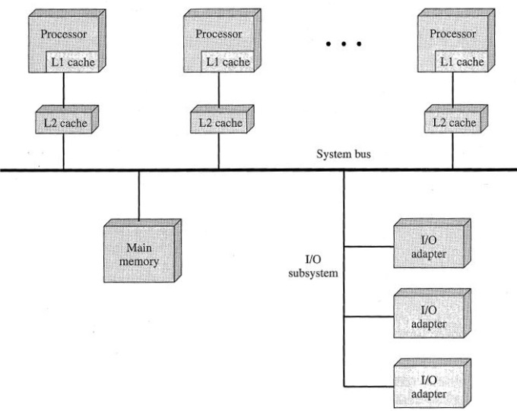
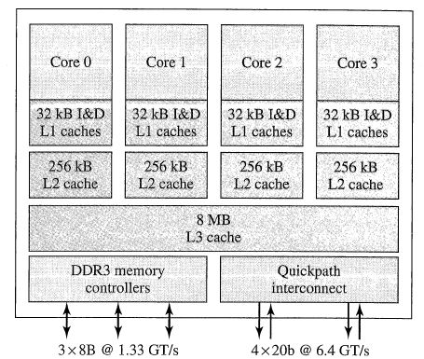
Multi (processor/core)
Traditionally, the computer has been viewed as a sequential machine.
Multiple control signals
Pipelining
Parallelism
Symmetric Multiprocessors (SMP)
2 or more identical processors that share resources
Integrated OS to control jobs, tasks, files, data elements…
High degree of interaction/cooperation between processes
Multicore Computers
Single piece of silicon (die)
Independent processors + levels of cache
Intel Core i7
Prefetching
Cluster computing
Loosely coupled - network
Client / server environment
Middleware
DME, RPC

Slide 21
Learning Objectives
Describe the basic elements of a computer system and their interrelationship.
Explain the steps taken by a processor to execute an instruction.
Understand the concept of interrupts and how and why a processor uses interrupts
List and describe the levels of a typical computer memory hierarchy.
Explain the basic characteristics of multiprocessor and multicore organization.
Discuss the concept of locality and analyze the performance of a multilevel memory hierarchy.
Understand the operation of a stack and its use to support procedure call and return.

Slide 22
Given:
Processor speed is faster than memory speed
Execution/data localizes
Processor Cache:
Contains a portion of main memory
Invisible to operating system
Used similar to virtual memory
Increases the speed of memory
Processor first checks cache - If not found in cache, the block of memory containing the needed information is moved to the cache
Disk cache, I/O cache, VM cache,…

Slide 23
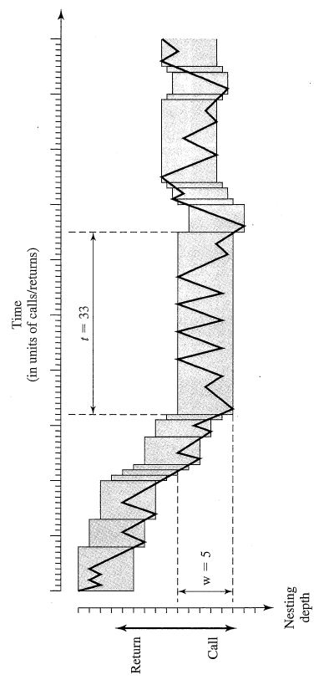
Two-Level Memory
Locality
Spatial locality – clustered access
Large cache
Pre-fetch
Temporal locality – recent/repeated access
Cache Least Recently Used (LRU)
Cache hierarchy

Slide 24
Learning Objectives
Describe the basic elements of a computer system and their interrelationship.
Explain the steps taken by a processor to execute an instruction.
Understand the concept of interrupts and how and why a processor uses interrupts
List and describe the levels of a typical computer memory hierarchy.
Explain the basic characteristics of multiprocessor and multicore organization.
Discuss the concept of locality and analyze the performance of a multilevel memory hierarchy.
Understand the operation of a stack and its use to support procedure call and return.

Slide 25
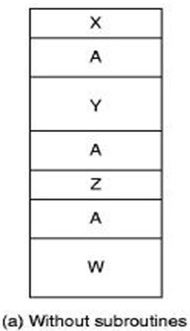
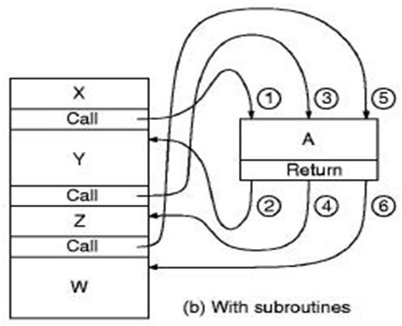
The Call / Return Mechanism
Subroutines
Smaller programs.
Easier to maintain.
Reduces development costs.
Increased reliability.
Fewer bugs do to copying code.
More library friendly.
Faster programs.
Less overhead.

Slide 26
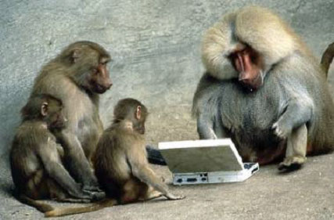

Slide 27
Summary…

Slide 28
What is an O.S.?
Summary
Not always a clear definition as to what constitutes an O.S. and what is an application
CD-Rom Driver
Scandisk
Internet Explorer
Intermediary between the hardware and the users
Allocate resources (CPU, Memory, disk space, etc.) between programs and users efficiently
Allow the user to conveniently access data and programs
Protect the system from incorrect or malicious programs and users

Slide 29
Hardware Review
Summary
Elements of a system:
Processor
Registers (address, data, control)
Instruction cycle (fetch, decode, execute)
Interrupts
Usually includes hardware and special instructions to help the O.S. manage memory, devices, etc.
Memory
Different levels (cache, main memory, disk)
Operating system will generally manage memory (both RAM and disk), and move data back and forth as required
I/O
Usually use Interrupts, DMA
Operating system usually controls use of I/O devices

Slide 30
Registers
Summary
Used for frequently accessed items
User-Visible registers – Available to the programmer and compiler
Data Registers
Address Registers (Index, Segment, Stack Pointer)
Condition code/flags
Control and Status registers – Used to control the processor
Program Counter/Instruction Pointer
Memory address/data
Processor Status Word
Debugging registers
Temp registers
Memory Management registers

Slide 31
Interrupts
Summary
Interrupts
Allow I/O devices to get the CPUs attention at regular intervals (Program, Timer, I/O, Hardware failure)
Helps the O.S. by reducing the time spent monitoring I/O devices
CPU checks for interrupts after each instruction, starts the handler if needed
May allow nested interrupts
I/O techniques
Programmed I/O
Interrupt-Driven I/O
Direct Memory Access

Slide 32
Interrupts and I/O
Summary
Handling and Interrupts:
Figure 1.10 (pg 23)
Device sends interrupt request to CPU
CPU finishes current instruction
CPU acknowledges request
CPU saves PC and PSW
CPU loads PC with the address of the first instruction in the interrupt handler (may get help from interrupt request)
Interrupt handler starts, often saves other CPU registers and key values
Interrupt handler responds to the device
Interrupt handler restores CPU registers and key values
CPU restores PC and PSW and resumes previous program

Slide 33
Memory
Summary
Varying types of memory
Registers, Cache, RAM, Disk, CD
Vary in speed, size, cost
CPU and O.S. try to keep frequently used data in faster memory
Cache – Use a small high-speed memory to improve the apparent speed of a larger low-speed memory
Keep track of what is currently being used, load into high-speed memory
Replacement Algorithm – What do we get rid of when we run out of memory?
Write Policy – How do we respond to modifications?

Slide 34
Finally…
Operating System Tradeoffs
Convenience vs efficiency
Ease of use vs maximum resource utilization
Interactive user interface vs no user view
Asymmetric vs symmetric processing
Single-processor vs multiprocessor systems
Unicore vs multicore systems
UMA vs NUMA
Batch vs time sharing
Logical vs physical memory
Dual mode vs multimode
Notes:
UMA = uniform memory access
Non-uniform memory access (NUMA) is a computer memory design used in multiprocessing, where the memory access time depends on the memory location relative to the processor. Under NUMA, a processor can access its own local memory faster than non-local memory (memory local to another processor or memory shared between processors). The benefits of NUMA are limited to particular workloads, notably on servers where the data are often associated strongly with certain tasks or users.[

